Slide 1

Python! Day 6
While loops
Infinite while loops
For loops – repeat a set amount of times
Repeat based on a variable number of times via an int variable
For each loop
Improve shopping list program

Slide 2
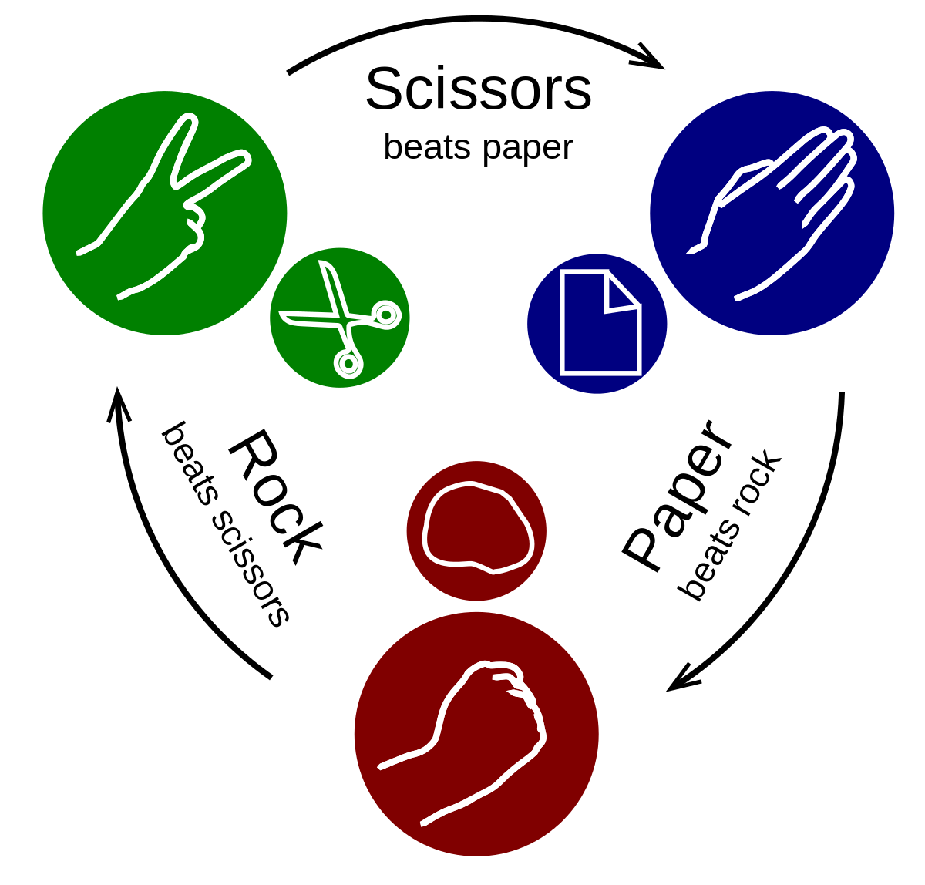
Warm-Up Project: Rock Paper Scissors
We can make a more fun version of our coin flip program by turning it into a rock-paper-scissors game where the user competes against the computer
The user would enter “rock” “paper” or “scissors” and the program would also choose “rock” “paper” or “scissors” based on a random number
Hint: use random.randint(1, 3) and if, elif, and else statements

Slide 3
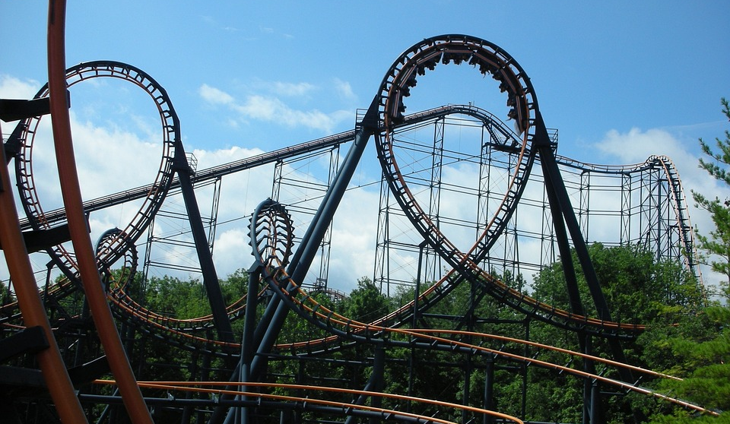
Loops
Loops are coding tools like if-else statements that make things repeat
For example, if we want to print something 10 times, it’d be annoying to write out the same thing 10 times in a row, instead, we can tell the program to just repeat the print statement 10 times
Some loops can even repeat forever, these are called infinite loops

Slide 4
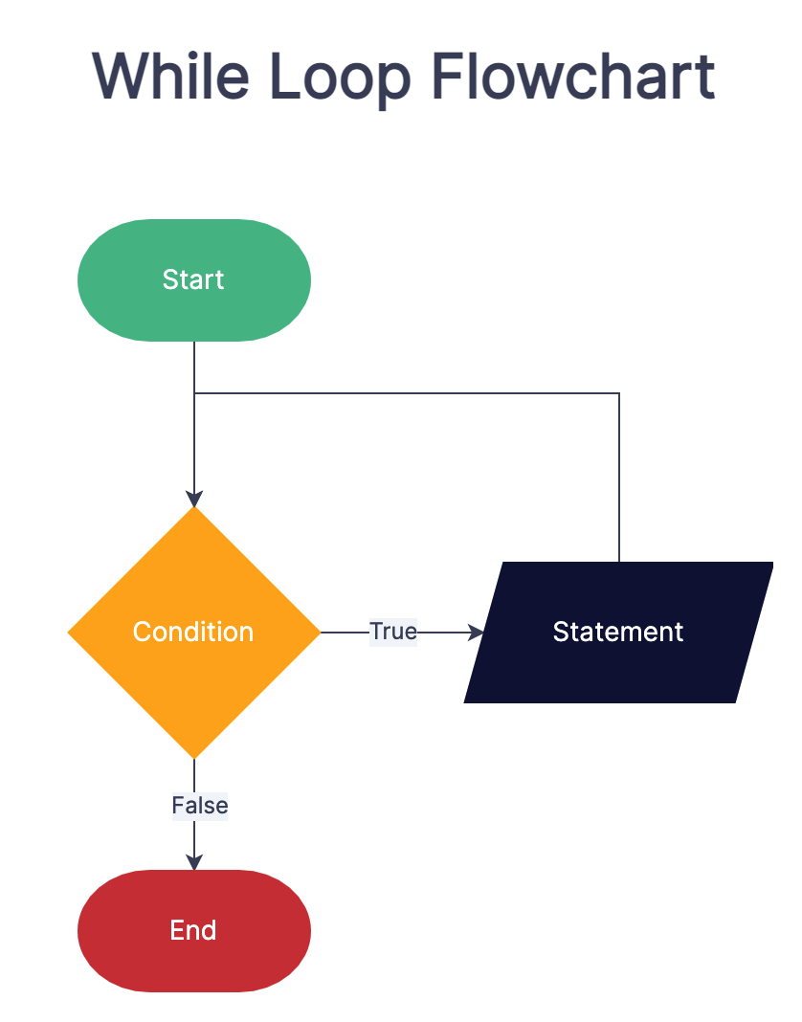
While Loops
The easiest to write loop is a while loop which will repeat if something is true
They’re written like this:
while condition:
do this
One version of a while loop might look like this:
while is_raining:
print(“plip plop”)
if weather != “rainy”:
is_raining = false
This program will print “plip plop” until the weather is no longer rainy

Slide 5

Project: Question Program
Let’s write a program that will if they want to answer a question over and over until they say “no” to “Do you want to answer a question?”
It would look something like this:
wants_to_answer_question = true
while wants_to_answer_question:
answer = input(“Do you want to answer a question? (y/n) ”)
if answer == “n”:
wants_to_answer_question = false

Slide 6

We can make this more useful by counting how many times the user has answered the question
This might look like:
wants_to_answer_question = true
count = 0
while wants_to_answer_question:
count = count + 1
answer = input(“Do you want to answer a question? (y/n) ”)
if answer == “n”:
wants_to_answer_question = false
print(“You answered the question “ + str(count) + “ times”)

Slide 7

Improve Shopping List Program
With these new skills we can make our shopping list program from the last class better
Let’s change the program so that the user can add as many items to the shopping list as they want instead of just 3 items
Try it out

Slide 8
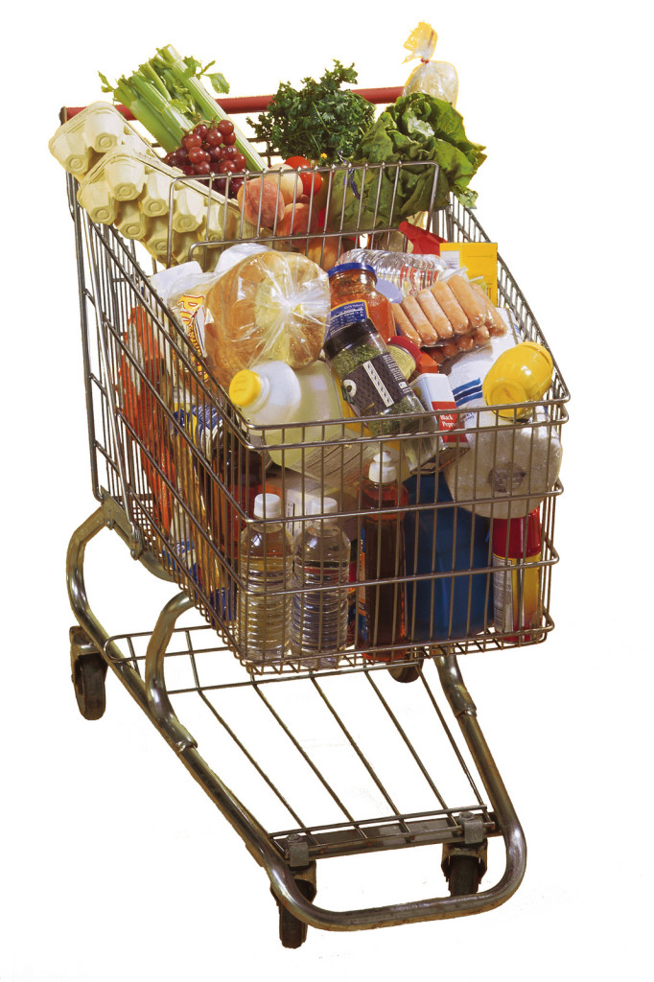
shopping_list = []
wants_to_add_more_items = true
while wants_to_add_more_items:
item = input(“New item: ”)
shopping_list.append(item)
answer = input(“Do you have more items to add? (y/n) “)
if answer == “n”:
wants_to_add_more_items = false
This Photo by Unknown Author is licensed under CC BY

Slide 9

Infinite Loops
One danger of while loops is that if the condition is always true, the program will go on forever
For example:
While 5 > 3:
print(“math”)
This program will print “math” forever
We usually don’t want this to happen
On old computers, an infinite loop could crash the computer, but now they just waste time

Slide 10

Counting With While Loops
If we want, we can use while loops to repeat something a set amount of times
It’d look something like this:
count = 0
while count < 3:
print(“hi”)
count += 1
This will print “hi” 3 times
Try writing a program that counts from 0 to 9

Slide 11
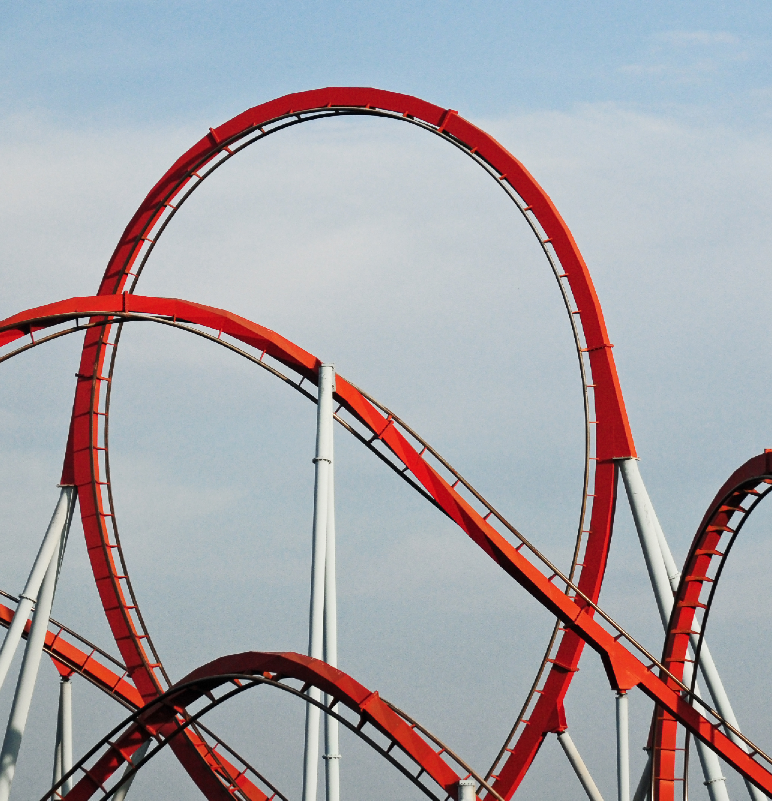
For Loops
For loops are essentially an easier way to count with a while loop
For loops look like this:
for count in range(start, end + 1, increment):
do this
A for loop that counts from 0 to 9 would look like this:
for count in range(0, 10, 1)
print(count)
You might notice that this has the same elements as when we count with a while loop

Slide 12
count = 0
while count < 10:
print(count)
count = count + 1
for count in range(0, 10, 1)
print(count)

Slide 13
For Loops Continued
One nice thing about for-loops is that it’s much harder to make an infinite loop
Try messing around with the for loop and see what happens
for count in range(0, 10, 2)
print(count)
added_count = 0
for count in range(0, 10, 1)
added_count += count
print(added_count)

Slide 14

Project: Box
Let’s create a function called print_box() that prints a box using for loops
The box might look like this:
---------------
| |
| |
---------------

Slide 15

print(“-------”)
for n in range(0, 2):
print(“| |”)
print(“-------”)
You can print a taller box by changing the numbers of the for loop
print(“-------”)
for n in range(0, 5):
print(“| |”)
print(“-------”)

Slide 16

Project: Pyramid
Let’s try a slightly harder project
Try printing a pyramid using a for-loop
The pyramid should look like this:
*
**
***
****
*****

Slide 17
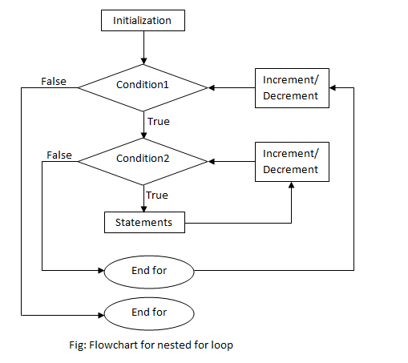
for n in range(1, 6):
output = “”
for num in range(0, n):
output += “*”
print(output)
For this, we need to use a for-loop inside a for-loop
This is called a nested for-loop

Slide 18

For Each Loops – Looping Through Lists
Last class, we learned how to create lists
What if we have a list of numbers like: [1, 2, 6, 8, 3, 0] and we want to print what every number is multiplied by three
For this we can use a for-each loop
For-each loops look like this:
for item in list_of_items:
do this
To print every item in the number list multiplied by 3, we’d write:
for number in number_list:
print(number * 3)

Slide 19

Restrictions of For-Each Loops
Notice that if we do this:
num_list = [1, 2, 3, 4, 5]
for num in num_list:
num *= 3
print(num_list)
The num list doesn’t change after the for-each loop
If we want to change every item of a list, we must use a for-loop like this
num_list = [1, 2, 3, 4, 5]
for n in range(0, len(num_list)):
num_list[n] *= 3
print(num_list)

